Slide 1
Plasma Diagnostic Techniques Lecture 2: Optical Emission Spectroscopy
Deborah O’Connell
York Plasma Institute

Slide 2
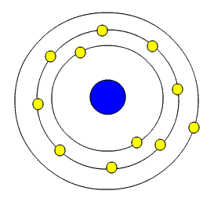
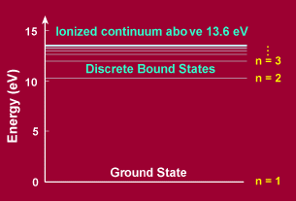
The Bohr Model of the Atom
Electrons in atoms and molecules can also be raised to higher energy states – electronically excited states
Nucleus
electrons
Electrons can only be in specific orbits around the central nucleus
These orbits have discrete energy states

Slide 3
Light Production - Excitation
One of the simplest ways to form excited states is to bombard atoms with energetic electrons
Usually excited states have short lifetimes (tens of nanoseconds) and decay – the electrons drop back to a lower energy state, eventually stopping at the lowest energy state – the ground state
Energy has to be given up in this process and this is normally through the emission of a photon
Electron impact excitation:
hν

Slide 4
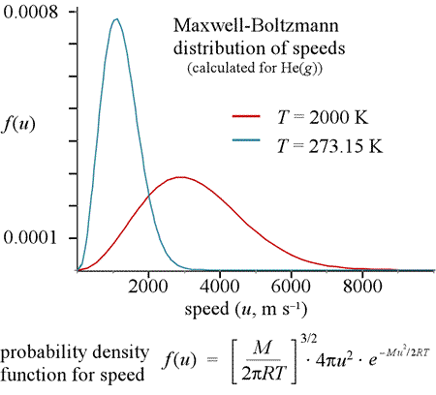
Electron velocity distribution functions

Slide 5
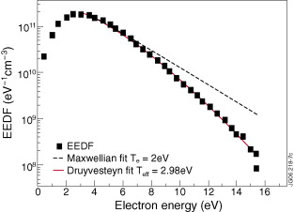
Electron energy distribution function
Example: Druyvesteyn distribution
Notes:
Comparison of a fit to data for a Maxwellian and Druyvesteyn distribution

Slide 6
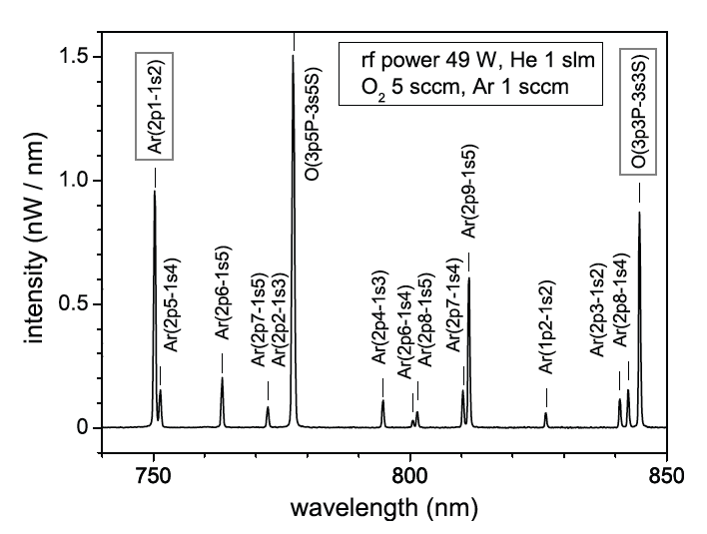
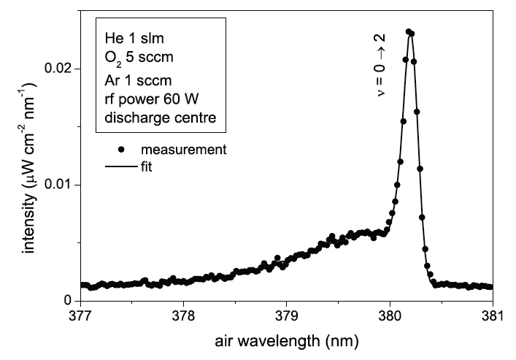
Optical Emission Spectroscopy (OES)
line emission
which emission lines (qualitative)
species
absolute intensities (calibration difficult)
density of excited species
line ratios
robust model based analysis
line shapes (high experimental requirements)
temperatures, fields, densities
temporal variations
plasma dynamics
continuum radiation
spectral distributions
absolute intensities

Slide 7
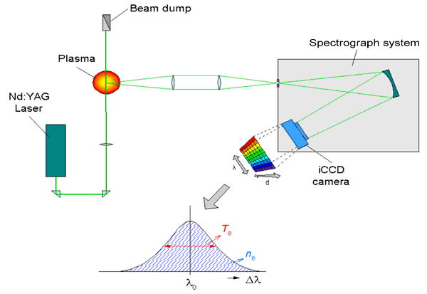
Examples of active optical techniques
Thomson scattering (top figure)
Laser induced fluorescence (bottom figure)
Interferometry
Photo-detachment
Absorption spectroscopy
Cavity ring down spectroscopy

Slide 8
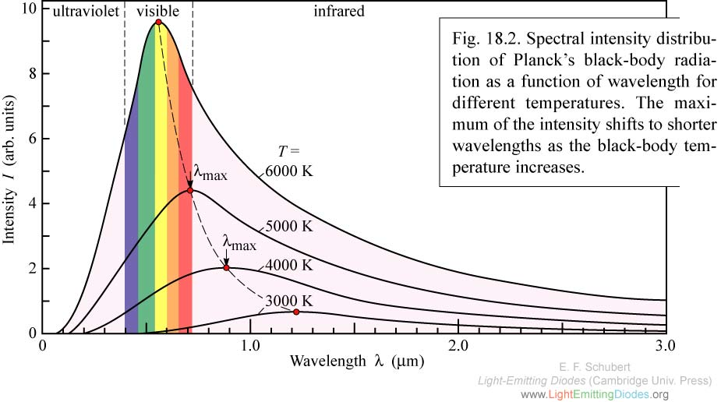
Plasma concepts - CTE
Complete thermodynamic equilibrium (CTE)
homogeneity
unique temperature (T_{e} = T_{i} = T_{gas})
black body radiation
Maxwell-Boltzmann distribution describes the population of excited states for all components
Practically not possible in the laboratory, thermal plasmas often modeled for simplicity

Slide 9
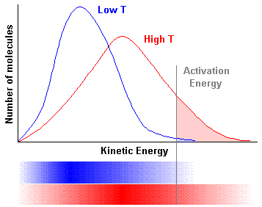
Plasma concepts - CTE
Maxwell-Boltzmann distribution
population distributions
Spectroscopy: line intensities and ratios
velocity distribution
Spectroscopy: line shape, e.g. Doppler effect

Slide 10

Plasma concepts - CTE
Main constraints and limitations
inhomogeneities
Planck
Local thermodynamic equilibrium?

Slide 11

Plasma concepts - LTE
Local thermodynamic equilibrium (LTE)
local parameters
collision dominated
equilibrium of collisions
no equilibrium of radiation
requirement
example (hydrogen arc)
n_{e} = 10¹⁶ cm⁻³, T_{e} ≈ 10⁴ K
(E_{k} - E_{i})_{LTE} ≈ 4 eV
Partial LTE

Slide 12
Plasma concepts - PLTE
Partial local thermodynamic equilibrium (PLTE)
over population of the ground state
LTE for excited states
constraints and limitations
low electron densities
Corona model
collisional radiative models

Slide 13
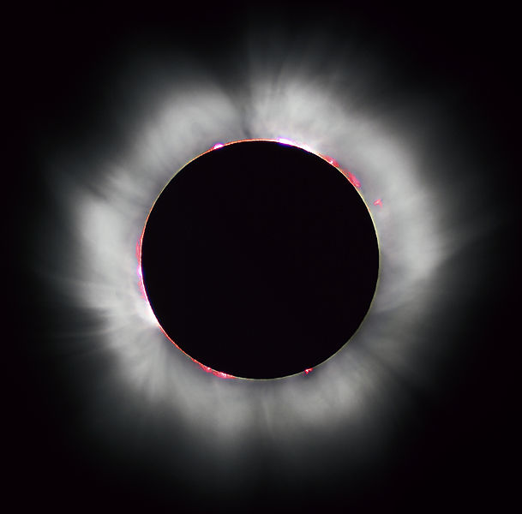
Plasma concepts - Corona
Corona model
model for plasmas with "low" electron densities (n_{e} < 10¹³ cm⁻³)
applicable to most technological plasmas
far from thermodynamic equilibrium
most particles are in the ground state
electron impact excitation = relaxation by radiation
(spontaneous emission)

